Slide 1
Group Project Cellular Automata
Joseph Cox
Kelvin S. P. Dong
Bishop Clark
Mauzor Ilonzo

Slide 2
Von Neumann Replication Machine
Original[s] Tarting Point
1
Confluent cell
2
Pulse is cycled & carried through the system.
A new wire is added to the system & the process repeats
Confluent cell is excited
3
4

Slide 3
Von Neumann Replication Machine Example Configuration

Slide 4
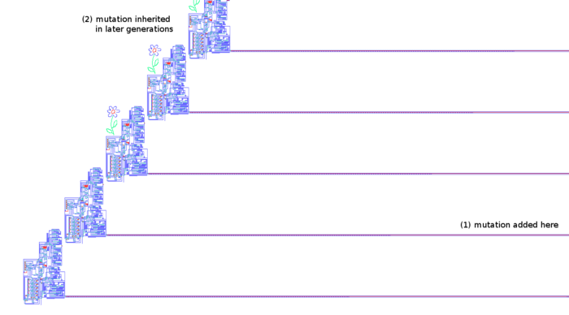
Von Neumann’s Self-Reproducing Automata Link
http://www.dtic.mil/dtic/tr/fulltext/u2/688840.pdf

Slide 5
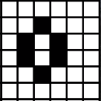
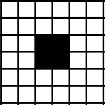
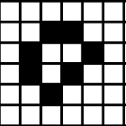
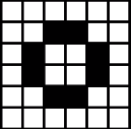
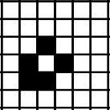
Conway’s Game of Life Patterns Still Lifes
Beehive
Block
Loaf
Tub
Boat

Slide 6
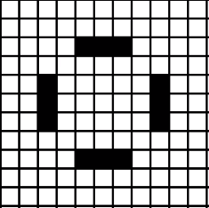
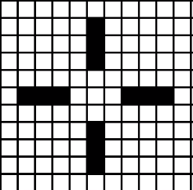
Conway’s Game of Life Patterns Oscillators
Blinker

Slide 7
Conway’s Game of Life Patterns Spaceships
Glider

Slide 8
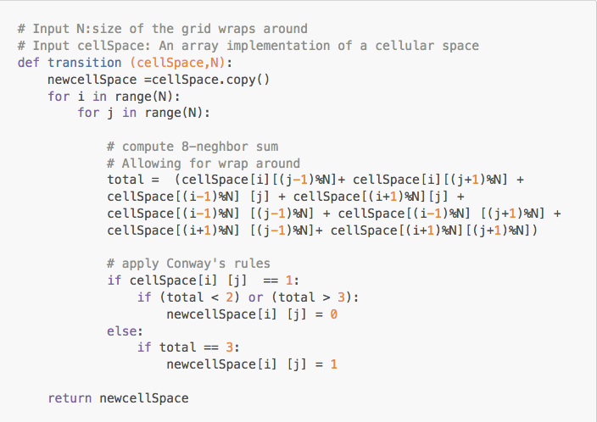
Transition Function in Python

Slide 9
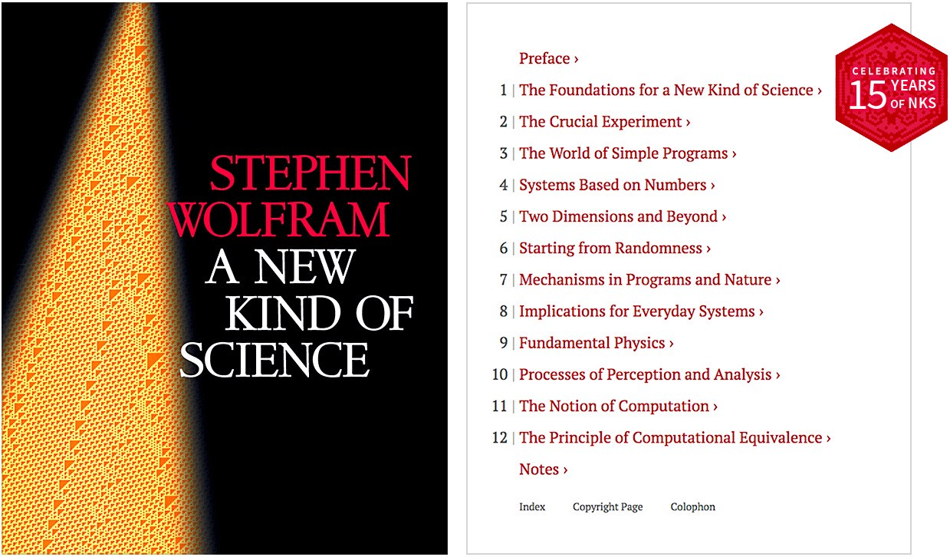
A New Kind of Science Stephen Wolfram
https://www.wolframscience.com/nks/

Slide 10
Elementary Cellular Automata
ECA is a one-dimensional cellular automata with two states.
Cells in next generation are determined by current cells neighborhood.
There are 4 types of ECAs:
Uniformity
Repetition
Random
Complexity

Slide 11
Elementary Cellular Automata
Sierpinski’s Triangle
Sierpinski's Triangle is a representation of a ECA using a single cell (1) in generation 0.
The amount of states in each generation is (2 * generation) + 1.

Slide 12
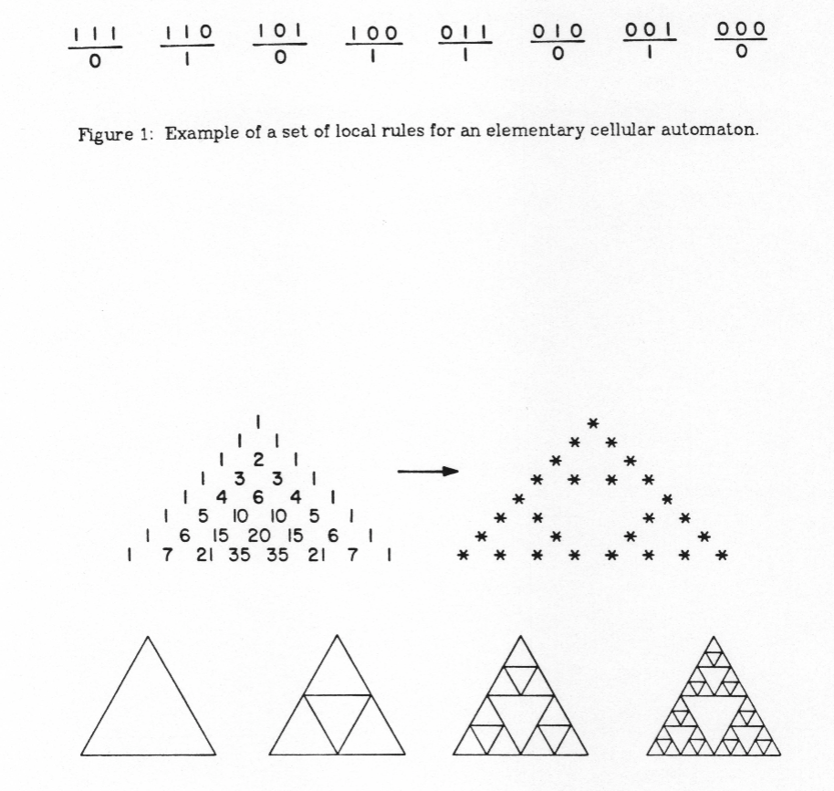
Elementary Cellular Automata - Rule 90 Pascal’s & Sierpinski’s Triangle

Slide 13
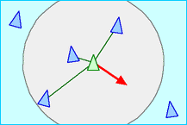
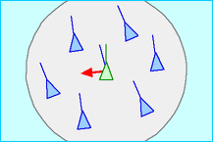
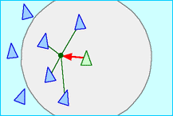
The Three Steering Behaviors of Boids
Separation
Alignment
Cohesion

Slide 14
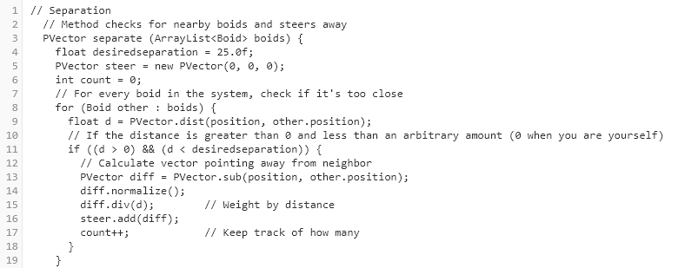
The Three Steering Behaviors of Boids
Separation: Code in Processing JavaScript

Slide 15
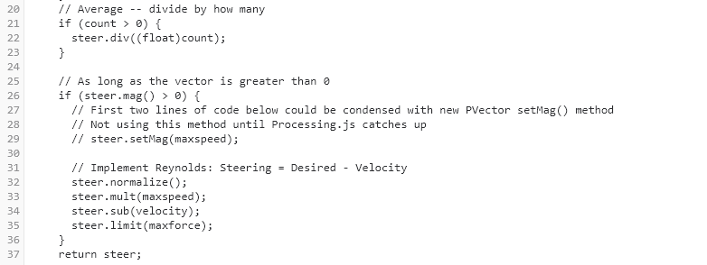
The Three Steering Behaviors of Boids
Separation: Code in Processing JavaScript Cont.

Slide 16
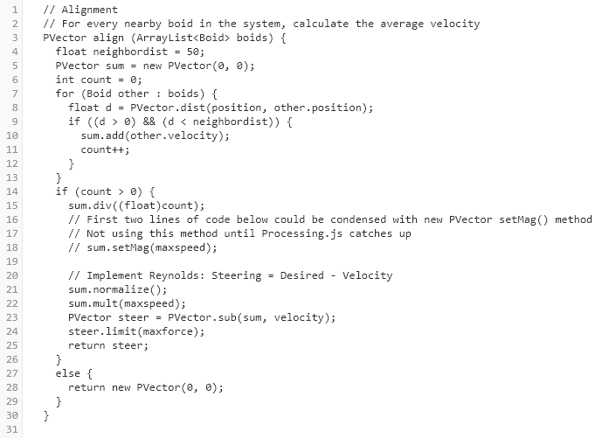
The Three Steering Behaviors of Boids
Alignment: Code in Processing JavaScript

Slide 17
The Three Steering Behaviors of Boids
Alignment: Code in Processing JavaScript Cont.

Slide 18
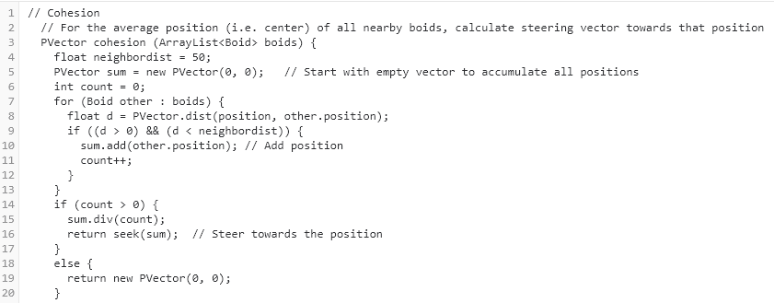
The Three Steering Behaviors of Boids
Cohesion: Code in Processing JavaScript

Slide 19
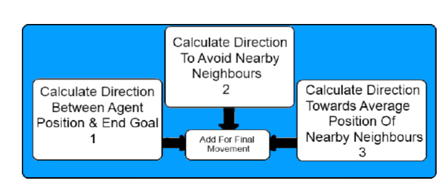
Cellular Automata
Approach to Flocking

Slide 20
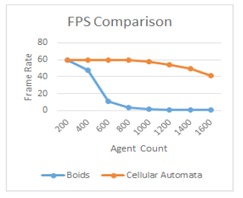
Cellular Automata Frames per Second Comparison
CA Approach vs. Boids

Slide 21
Quantum Cellular Automata
History & Origins
Richard Feynman’s introduction of quantum computation in 1982.
David Deutsch’s definition the Quantum Turning Machine in 1985.
Gerhard Grossing & Anton Zeilinger introduce Q.C.As, coining the term and providing the first definition in 1988.

Slide 22
Q.C.A Cell
Device Diagram
Electron
Quantum Dots
Quantum Dots
Electron

Slide 23
Q.C.A Device
Cell States
Each Q.C.A device has 3 possible states depending on how the barriers in the cell’s tunneling sections are raised or lowered.
Null State
P = -1
P = +1

Slide 24
Q.C.A Cell
Polarized Q.C.A Cell States Diagram
P = -1
[Represents Binary 0]
P = +1
[Represents Binary 1]

Slide 25
Works Cited
[1] A. W. Burks, Von Neumann’s Self-Reproducing Automata, Office of Research Administration, Ann Arbor, MI, tech., 1969.
[2] S. Wolfram, A New Kind of Science. Wolfram Media, 2002.
[3] S. Wolfram, Cellular Automata as Simple Self-Organizing Systems.
[4] D. Shiffman, The Nature of Code. 2012.
[5] E. W. Weisstein, Elementary Cellular Automaton, Wolfram MathWorld.[Online].Available:http://mathworld.wolfram.com/ElementaryCellularAutomaton.html.
[6] K. E. Stiefel, Fractals in Frozen, Science On, 29-Dec-2016. [Online]. Available: https://scienceonblog.wordpress.com/2017/01/19/fractals-in-frozen/.
[7] J. Shannon, Exploring the real world applications of cellular automata and its application to the simulation of flocking behaviour, Aug. 2013.
[8] D. Shiffman, Flocking. [Online]. Available: https://processing.org/examples/flocking.html.
[9] C. Reynolds, Boids: Background and Update, Steering Behaviors For Autonomous Characters. [Online]. Available: https://www.red3d.com/cwr/boids/.
[10] R. Feynman. Simulating physics with computers. International Journal of Theoretical Physics, 21:467488, June 1982.

Slide 26
Works Cited Cont.
[11] D. Deutsch, Quantum Theory, the Church-Turing Principle and the Universal Quantum Computer, Proc. R. Soc. Lond., Vol. A400 (1985) 97-117
[12] G. Grssing and A. Zeilinger. Quantum cellular automata. Complex Syst., 2:197208, 1988.
[13] J. Watrous. On one-dimensional quantum cellular automata. In Proceedings of the 36th Annual Symposium on Foundations of Computer Science, pages 528537, October 1995.
[14] K. Wiesner, Quantum Cellular Automata, Aug. 2008
[15] D. A. Antonelli, D. Z. Chen, T. J. Dysart, X. S. Hu, A. B. Kahng, P. M. Kogge, R. C. Murphy, and M. T. Niemier, Quantum-Dot Cellular Automata (QCA) Circuit Partitioning: Problem Modeling and Solutions.
[16] International Technology Roadmap for Semiconductors (ITRS), 2015 Edition
[17] C.G. Smith. Computation without current. Science, 284:274, 1999.
[18] P.D. Tougaw and C.S. Lent. Logical devices implemented using quantum cellular automata. Journal of Applied Physics, 75:1818, 1994.
[19] U. Mehta and V. Dhare, Quantum-dot Cellular Automata (QCA): A Survey.
[20] D.Shiffman, ”The Coding Train” [Online]. Available: https://www.youtube.com/channel/UCvjgXvBlbQiydffZU7m1_aw

